Slide 1

Department of Computer Science and Engineering
MOBILE APPLICATION DEVELOPMENT
Reality Lock: Tamper-Evident Event Proof System for Mobile Devices
Presentation by
RAKESH S
ANBUCHELVAN GANESAN
Supervisor
EMBEDDED PROGRAMMING PROJECT-ZEROTH REVIEW

Slide 2
CONTENTS
Introduction
Problem Statement
Project Description
Aim and Scope of the Proposed work
Literature Survey
Hardware Component
Block Diagram Design
Project Planning

Slide 3
Introduction
In today's digital world, mobile devices capture millions of real-world events through photos, videos, sensor data, and communication records. However, current digital evidence can be easily manipulated using AI editing tools, metadata modification, deepfakes, and unauthorized alterations.
Examples:
Fake accident videos
Modified screenshots
Edited surveillance footage
False location claims
Manipulated digital documents
There is a growing need for a system that can prove:
"This event actually happened, at this exact time and location, and the evidence has not been modified."

Slide 4
Problem Statement
Existing Problem
Current mobile systems store data but do not guarantee authenticity.
A photo or video can be:
Edited after capture
Timestamp changed
Location manipulated
AI-generated
Re-uploaded with false context
Existing solutions verify files, but they cannot verify the complete event context.
Problem Definition
"Develop a mobile-based system that generates a tamper-evident digital certificate for real-world events by securely capturing, validating, and locking event information at the moment of occurrence."
Real-World Impact Areas
Legal evidence verification
Insurance claim validation
Emergency response
Journalism authenticity
Industrial safety monitoring
Digital identity protection

Slide 5
Project Description
Reality Lock is a mobile security system that creates a tamper-proof digital proof certificate for real-world events.
Captures
📷 Media 📍 Location ⏱ Timestamp 📱 Sensor Data
Process
Event Data → Hash Generation → Digital Signature → Secure Storage
Key Feature
Any modification changes the hash:
Original Hash ≠ New Hash → Tampering Detected
Output
Verified event proof with authenticity, time, and location validation.

Slide 6
Aim and Scope of the Proposed work
Aim
Develop a digital trust system that creates secure and verifiable proof of real-world events using mobile devices.
Objectives
✓ Prevent evidence manipulation ✓ Verify event authenticity ✓ Reduce digital fraud ✓ Build trust in mobile data
Scope
Short-Term:
Mobile application
Secure media capture
Hash & timestamp verification
Location authentication
Long-Term: Integration with: Smart Cities | Law Enforcement | Insurance | Healthcare | IoT
Vision
"Proof of Reality in the Digital Age"

Slide 7
Literature Survey
Existing Technologies
Digital Watermarking → Protects ownership but can be removed or modified.
Blockchain Evidence Storage → Provides data immutability but does not verify real-world event authenticity.
Digital Signatures → Verify sender identity but not event conditions.
AI Deepfake Detection → Detects manipulation but cannot prove original capture time.
Research Gap
Existing methods verify data, but not the complete reality of an event.
Proposed Improvement
Reality Lock combines Cryptography + AI + Sensor Fusion + Secure Logging to create trusted event proof.

Slide 8
Component
📱 Frontend: Android (Kotlin)
⚙️ Backend: Node.js / Python
🔐 Security: SHA-256 Hashing + Encryption
☁️ Storage: Firebase / Cloud Database
🤖 AI: Deepfake & Authenticity Detection
📍 Sensors: GPS + Camera + Motion Sensors
⛓ Future: Blockchain Integration

Slide 9
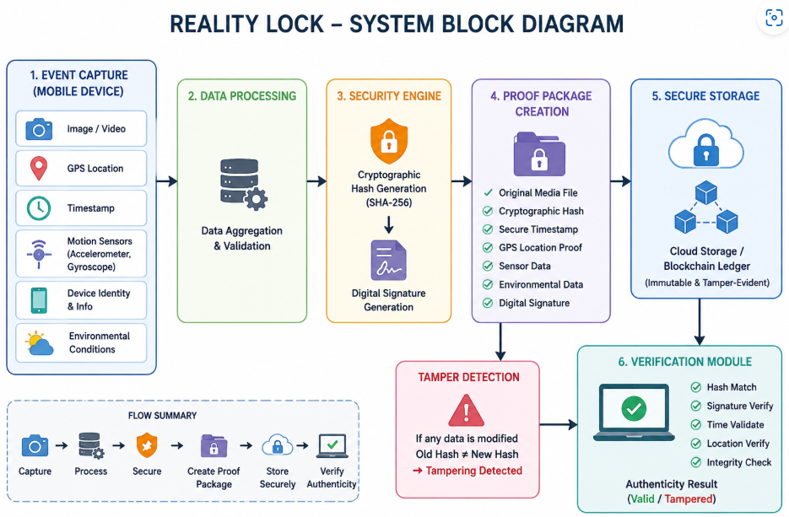
Block Diagram Design

Slide 10
Project Planning
Phase 1: Research & Design
Problem analysis
System architecture design
Phase 2: Development
Android app development
Sensor & camera integration
Hash generation module
Phase 3: Security Implementation
Encryption
Digital signature
Tamper detection
Phase 4: Testing & Deployment
Accuracy testing
Security validation
Final prototype

